Slide 1
Python Projects in Applied Optimization

Slide 2
Introduction to Python
Installing Python (Anaconda) or Use on the fly kernel (e.g. kaggle)
Loginto your kaggle account

Slide 3
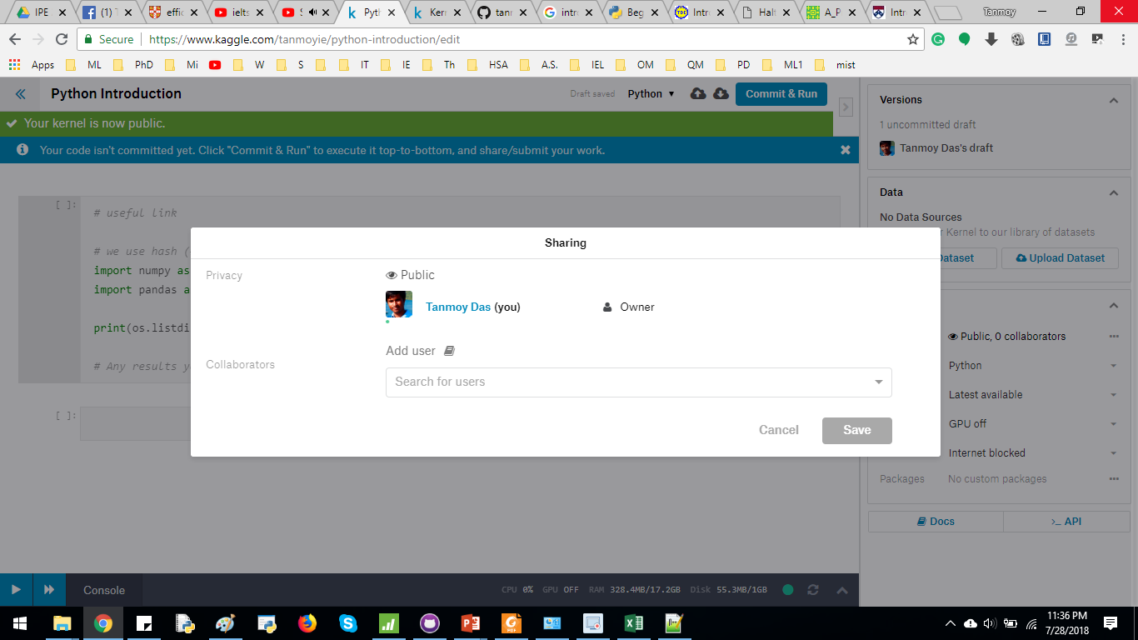
Introduction to Kaggle kernel
Once logged in, click KERNEL at the top right corner, then click NEW KERNEL
From the RIGHT side bar, make the KERNEL “public”. Add tanmoyie as an user/contributor

Slide 4
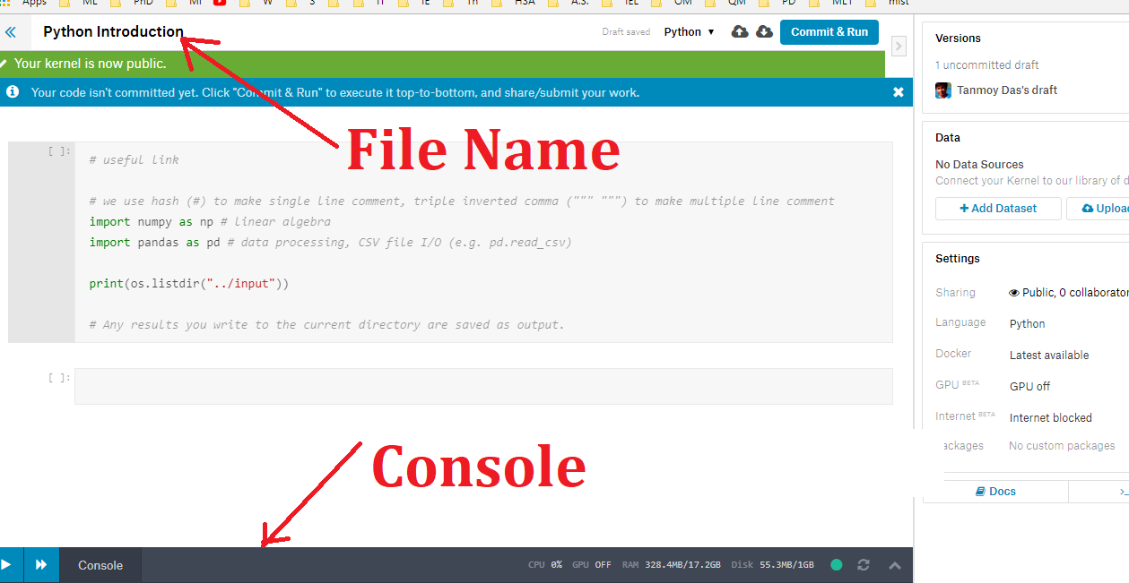
Introduction to Kaggle kernel
Name the file
There is a console in the bottom left corner

Slide 5
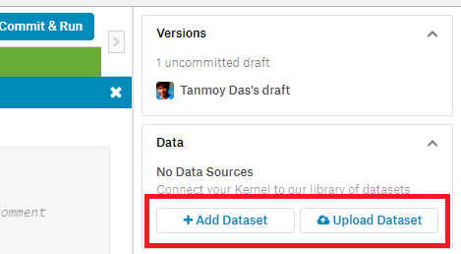
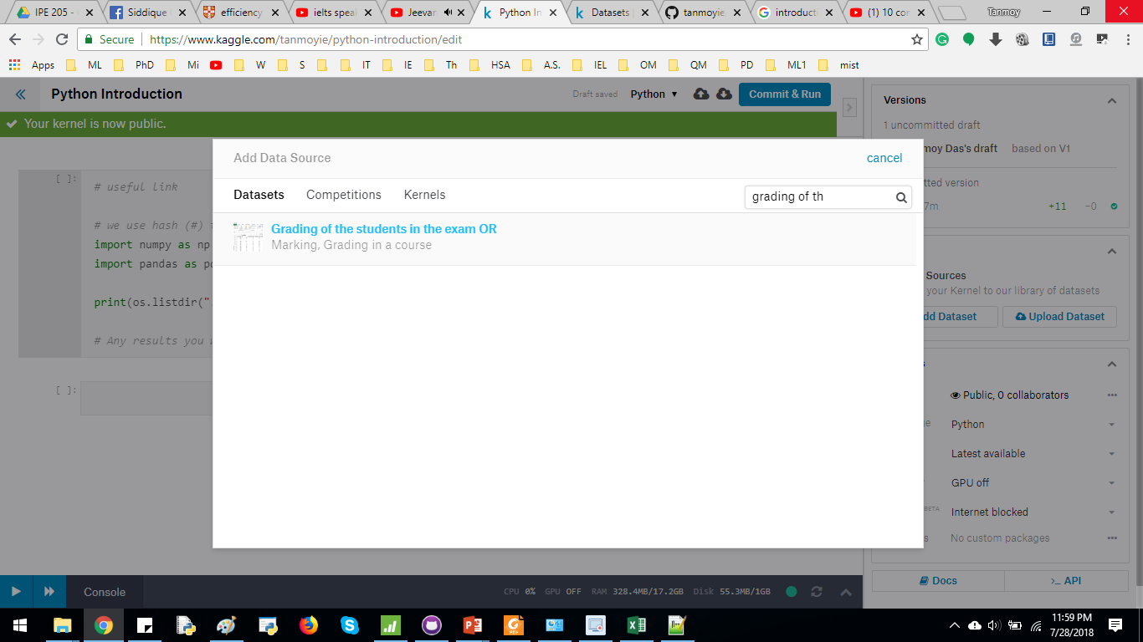
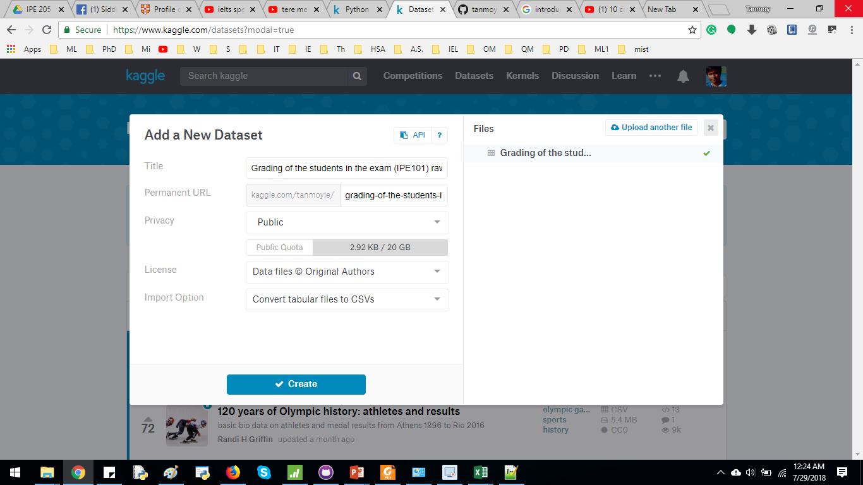
Introduction to Kaggle kernel
You can upload a new dataset from right hand side bar. Additionally, you can use someone else’s dataset (add Dataset)

Slide 6
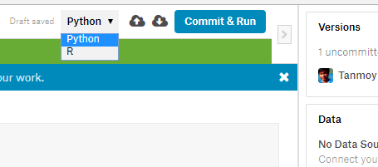
Introduction to Kaggle kernel
Select the Programming language (Python/R)
Commit & Run to run the entire program & make it visible to public.
2 Arrows to add cell above & below the current cell respectively.

Slide 7
Collect the Data
Show how I prepare the uploaded dataset
steps from EMS, copy+paste in new Excel file, processing, save as csv

Slide 8
Data Cleaning
Delete unnecessary row/column
Dealing with NA values

Slide 9
Scatter Plot

Slide 10
Box Plot
https://matplotlib.org/api/_as_gen/matplotlib.pyplot.boxplot.html

